Slide 1
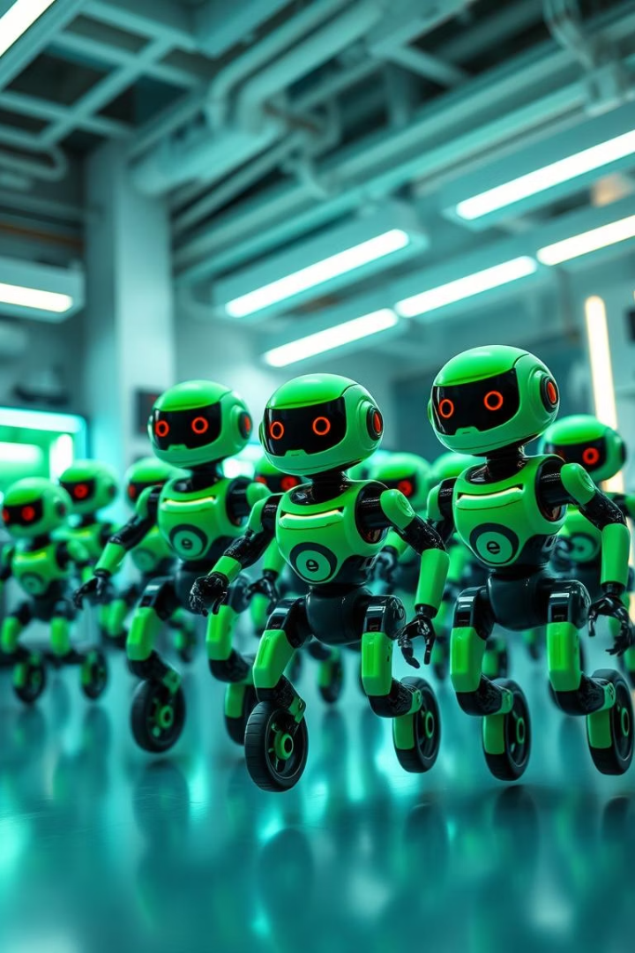
Project Beebot: Swarm Robotics Platform
EG / 2021 / 4458 - Dayananda G. G. A. I.
EG / 2021 / 4605 - Kasthuriarachchi K. A. A. D.
EG / 2021 / 4858 - Weerasiri G. M. I.

Slide 2
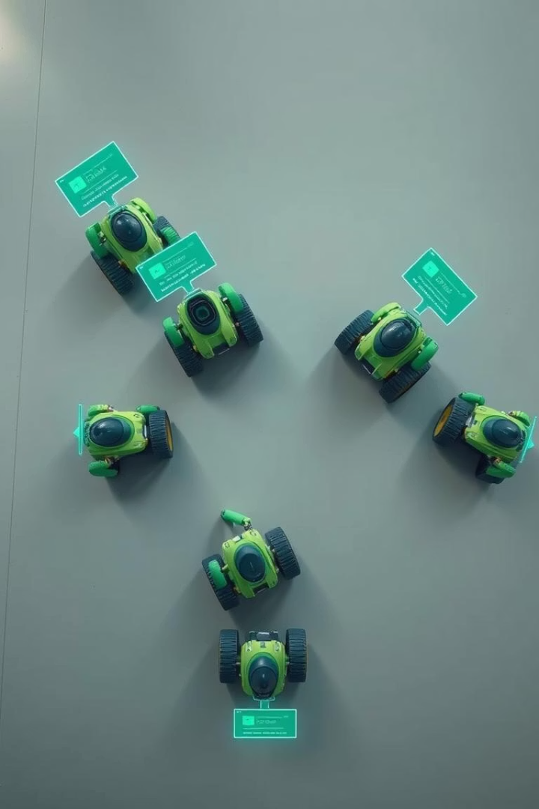
System Architecture
Overhead Camera
A 1080p HD camera that localizes the robots and identifies AR markers for accurate positioning.
Central Platform Microprocessor
Utilizes a Raspberry Pi to coordinate the swarm robots and manage their task allocation.
ESP-32 Based Robots
Each robot is equipped with an ESP32 microcontroller, which communicates wirelessly with the central Raspberry Pi.
3D Web Interface
Provides interactive visualization and control of robots through a Three.js-based platform.

Slide 3
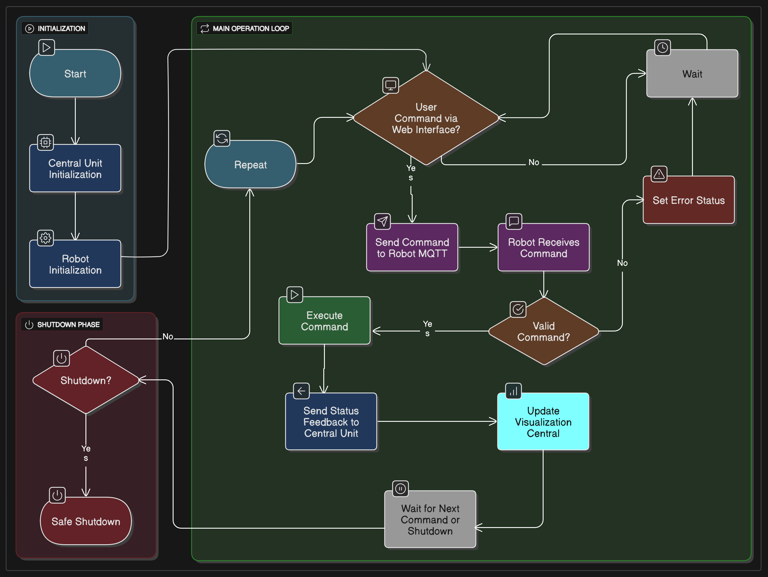
Firmware Flow Chart

Slide 4
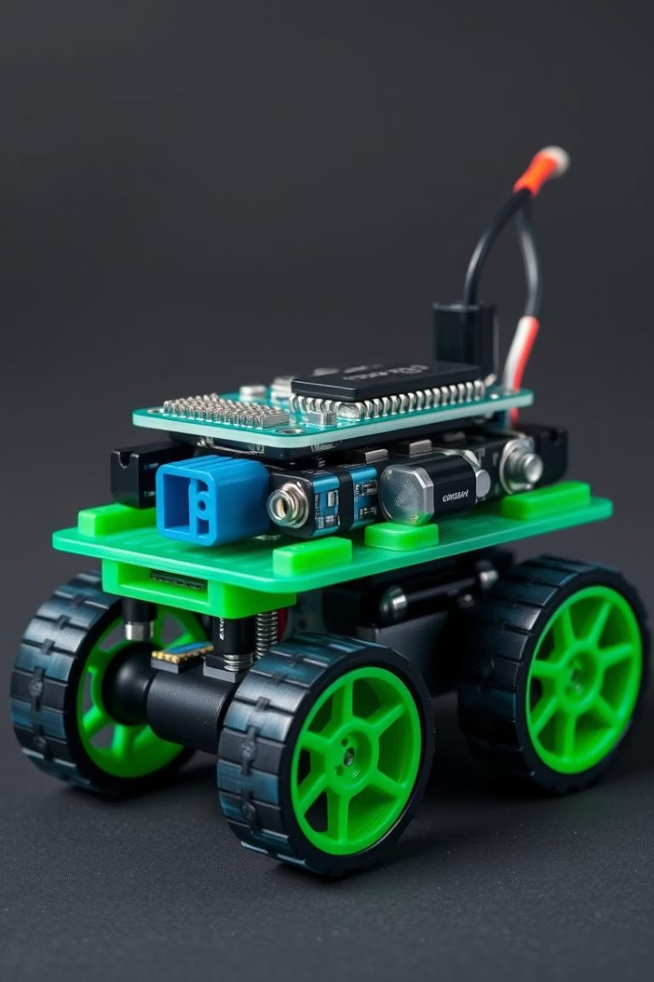
Robot Design & Hardware
Core Components
Power & Structure
ESP32 Microcontroller with Wi-Fi/Bluetooth
2 LiPo Batteries, 800mAh at 7.4V
Motor Driver: TB6612FNG, durable and efficient
Dot Board chassis, lightweight and modifiable
Gyroscope for heading correction
Compact and efficient circuit layout for space optimization

Slide 5

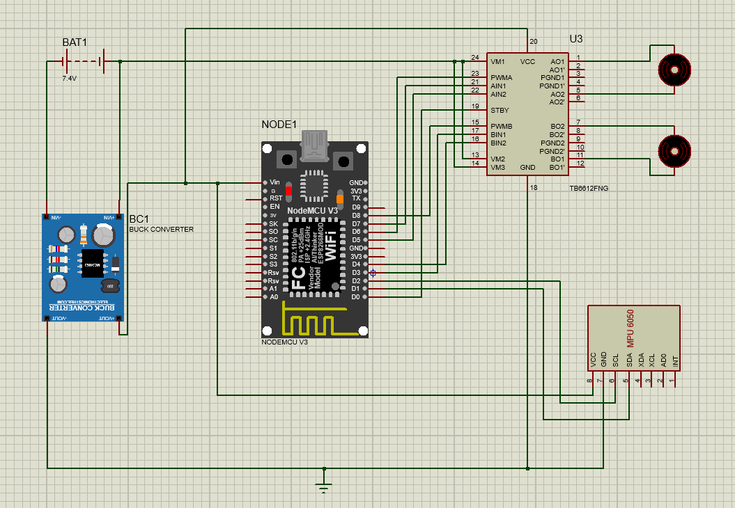
Proteus Design

Slide 6
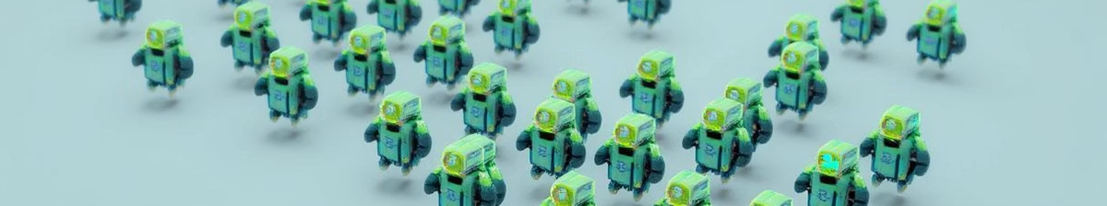
Project Progress So Far
Robot Development
AI Marker & Image Processing
3D Interface
Hardware Design
Partially developed 3D web interface displaying the arena.
Designed PCB layouts and schematic diagrams for robot electronics.
Created one of two swarm robots equipped with ESP32 and sensors.
Generated AI marker and implemented image processing to identify robots from overhead camera.

Slide 7
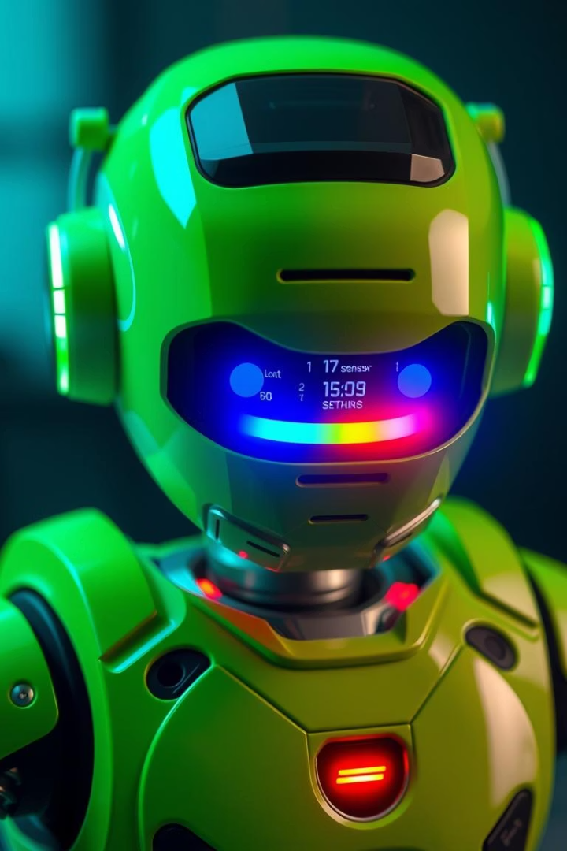
Future Work and Remaining Tasks
1
Create Additional Robot
2
Set Up Server and Backend
Develop the second robot for the swarm platform.
Establish a server to host the 3D web interface for visualization and control.
3
Develop Robot Algorithms
4
Configure Raspberry Pi
Design and implement algorithms to enable swarm behaviors and obstacle avoidance.
Set up the Raspberry Pi as the central unit coordinating robot tasks.
5
Implement Communication Protocols
Manage MQTT and other protocols for reliable robot-central unit communication.

Slide 8
Thank You
We appreciate your time and attention.
Please feel free to reach out with any questions or feedback.

